Slide 1
CS4100: 計算機結構
Designing a Single-Cycle Processor
國立清華大學資訊工程學系
一零零學年度第二學期

Slide 2
Outline
Introduction to designing a processor
Analyzing the instruction set
Building the datapath
A single-cycle implementation
Control for the single-cycle CPU
  Control of CPU operations
  ALU controller
  Main controller
Single-cycle Design-<number>

Slide 3
Introduction
§4.1 Introduction
CPU performance factors
  Instruction count
    Determined by ISA and compiler
  CPI and Cycle time
    Determined by CPU hardware
We will examine two MIPS implementations
  A simplified version
  A more realistic pipelined version
Simple subset, shows most aspects
  Memory reference: lw, sw
  Arithmetic/logical: add, sub, and, or, slt
  Control transfer: beq, j
Single-cycle Design-<number>

Slide 4
Instruction Execution
PC → instruction memory, fetch instruction
Register numbers → register file, read registers
Depending on instruction class
  Use ALU to calculate
    Arithmetic result
    Memory address for load/store
    Branch target address
  Access data memory for load/store
  PC ← target address or PC + 4
Single-cycle Design-<number>

Slide 5
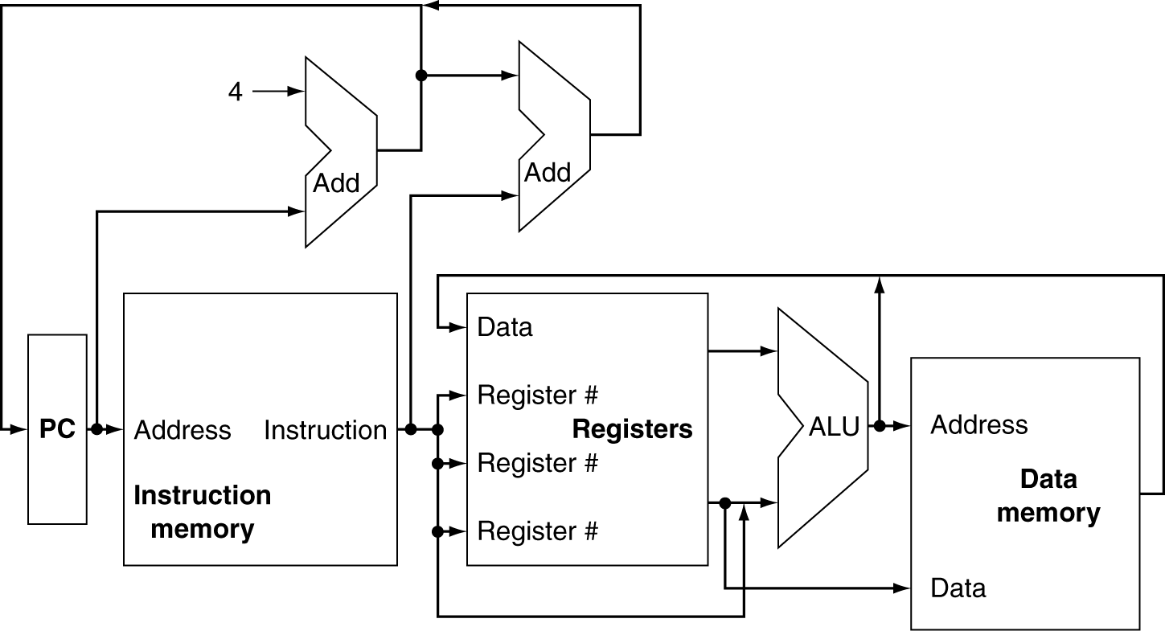
CPU Overview
Single-cycle Design-<number>

Slide 6
Multiplexers
Can’t just join wires together
  Use multiplexers
Single-cycle Design-<number>

Slide 7
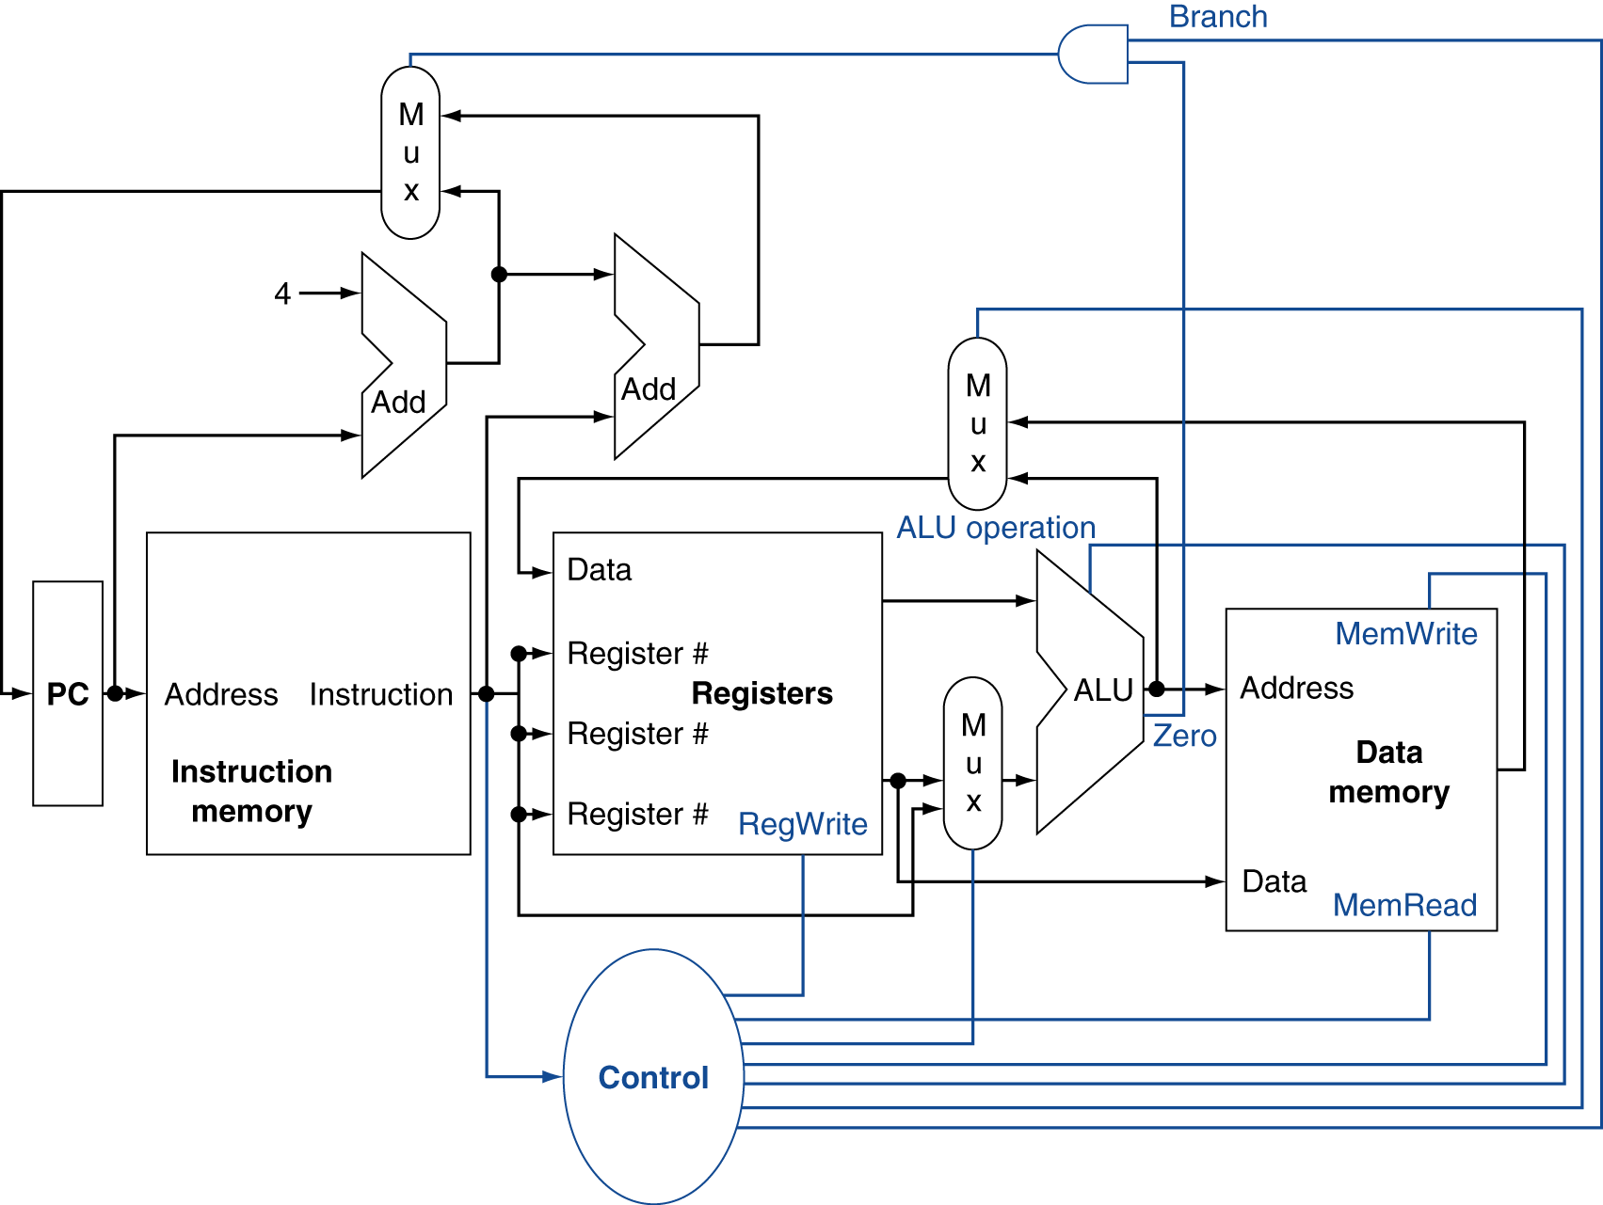
Control
Single-cycle Design-<number>

Slide 8
Logic Design Basics
Information encoded in binary
  Low voltage = 0, High voltage = 1
  One wire per bit
  Multi-bit data encoded on multi-wire buses
Combinational element
  Operate on data
  Output is a function of input
State (sequential) elements
  Store information
§4.2 Logic Design Conventions
Single-cycle Design-<number>

Slide 9
Combinational Elements
Adder
  Y = A + B
AND-gate
  Y = A & B
A
+
Y
B
A
Y
B
Arithmetic/Logic Unit
  Y = F(A, B)
Multiplexer
  Y = S ? I1 : I0
A
I0
M
u
x
Y
Y
ALU
I1
B
S
F
Single-cycle Design-<number>

Slide 10
Sequential Elements
Register: stores data in a circuit
  Uses a clock signal to determine when to update the stored value
  Edge-triggered: update when Clk changes from 0 to 1
Clk
D
Q
D
Clk
Q
Single-cycle Design-<number>

Slide 11
Sequential Elements
Register with write control
  Only updates on clock edge when write control input is 1
  Used when stored value is required later
Clk
D
Q
Write
Write
D
Clk
Q
Single-cycle Design-<number>

Slide 12
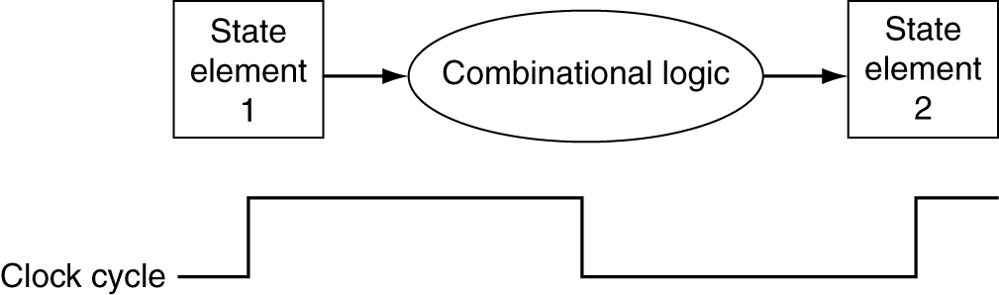
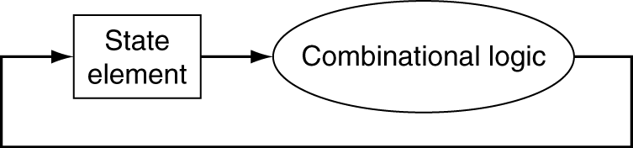
Clocking Methodology
Combinational logic transforms data during clock cycles
  Between clock edges
  Input from state elements, output to state element
  Longest delay determines clock period
Single-cycle Design-<number>

Slide 13
How to Design a Processor?
1. Analyze instruction set (datapath requirements)
  The meaning of each instruction is given by the register transfers
  Datapath must include storage element
  Datapath must support each register transfer
2. Select set of datapath components and establish clocking methodology
3. Assemble datapath meeting the requirements
4. Analyze implementation of each instruction to determine setting of control points effecting register transfer
5. Assemble the control logic
Single-cycle Design-<number>

Slide 14
Outline
Introduction to designing a processor
Analyzing the instruction set (step 1)
Building the datapath
A single-cycle implementation
Control for the single-cycle CPU
  Control of CPU operations
  ALU controller
  Main controller
Single-cycle Design-<number>

Slide 15
Step 1: Analyze Instruction Set
All MIPS instructions are 32 bits long with 3 formats:
  R-type:
  I-type:
  J-type:
The different fields are:
  op: operation of the instruction
  rs, rt, rd: source and destination register
  shamt: shift amount
  funct: selects variant of the “op” field
  address / immediate
  target address: target address of jump
31
26
21
16
11
6
0
op
rs
rt
rd
shamt
funct
6 bits
5 bits
5 bits
5 bits
5 bits
6 bits
31
26
21
16
0
op
rs
rt
immediate
6 bits
5 bits
5 bits
16 bits
31
26
0
op
target address
6 bits
26 bits
Single-cycle Design-<number>
Notes:
One of the most important thing you need to know before you start designing a processor is how the instructions look like.
Or in more technical term, you need to know the instruction format. One good thing about the MIPS instruction set is that it is very simple.
First of all, all MIPS instructions are 32 bits long and there are only three instruction formats: (a) R-type, (b) I-type, and (c) J-type.
The different fields of the R-type instructions are:
(a) OP specifies the operation of the instruction.
(b) Rs, Rt, and Rd are the source and destination register specifiers.
(c) Shamt specifies the amount you need to shift for the shift instructions.
(d) Funct selects the variant of the operation specified in the p?field.
For the I-type instruction, bits 0 to 15 are used as an immediate field. I will show you how this immediate field is used differently by different instructions.
Finally for the J-type instruction, bits 0 to 25 become the target address of the jump.
+3 = 10 min. (X:50)

Slide 16
Our Example: A MIPS Subset
R-Type:
  add rd, rs, rt
  sub rd, rs, rt
  and rd, rs, rt
  or rd, rs, rt
  slt rd, rs, rt
Load/Store:
  lw rt,rs,imm16
  sw rt,rs,imm16
Imm operand:
  addi rt,rs,imm16
Branch:
  beq rs,rt,imm16
Jump:
  j target
31
26
21
16
11
6
0
op
rs
rt
rd
shamt
funct
6 bits
5 bits
5 bits
5 bits
5 bits
6 bits
31
26
21
16
0
op
rs
rt
immediate
6 bits
5 bits
5 bits
16 bits
31
26
21
16
0
op
address
6 bits
26 bits
Single-cycle Design-<number>
Notes:
In today lecture, I will show you how to implement the following subset of MIPS instructions: add, subtract, or immediate, load, store, branch, and the jump instruction.
The Add and Subtract instructions use the R format. The Op together with the Func fields together specified all the different kinds of add and subtract instructions.
Rs and Rt specifies the source registers. And the Rd field specifies the destination register.
The Or immediate instruction uses the I format. It only uses one source register, Rs. The other operand comes from the immediate field. The Rt field is used to specified the destination register. (Note that dest is the Rt field!)
Both the load and store instructions use the I format and both add the Rs and the immediate filed together to from the memory address.
The difference is that the load instruction will load the data from memory into Rt while the store instruction will store the data in Rt into the memory.
The branch on equal instruction also uses the I format. Here Rs and Rt are used to specified the registers we need to compare.
If these two registers are equal, we will branch to a location offset by the immediate field.
Finally, the jump instruction uses the J format and always causes the program to jump to a memory location specified in the address field.
I know I went over this rather quickly and you may have missed something. But don worry, this is just an overview. You will keep seeing these (point to the format) all day today.
+3 = 13 min. (X:53)

Slide 17
Logical Register Transfers
RTL gives the meaning of the instructions
All start by fetching the instruction, read registers, then use ALU => simplicity and regularity help
MEM[ PC ] = op | rs | rt | rd | shamt | funct
or = op | rs | rt | Imm16
or = op | Imm26 (added at the end)
Inst Register transfers
ADD R[rd] <- R[rs] + R[rt]; PC <- PC + 4
SUB R[rd] <- R[rs] - R[rt]; PC <- PC + 4
LOAD R[rt] <- MEM[ R[rs] + sign_ext(Imm16)]; PC <- PC + 4
STORE MEM[ R[rs] + sign_ext(Imm16) ] <-R[rt]; PC <- PC + 4
ADDI R[rt] <- R[rs] + sign_ext(Imm16)]; PC <- PC + 4
BEQ if (R[rs] == R[rt]) then PC <- PC + 4 + sign_ext(Imm16)] || 00
else PC <- PC + 4
Single-cycle Design-<number>

Slide 18
Requirements of Instruction Set
After checking the register transfers, we can see that datapath needs the followings:
Memory
  store instructions and data
Registers (32 x 32)
  read RS
  read RT
  Write RT or RD
PC
Extender for zero- or sign-extension
Add and sub register or extended immediate (ALU)
Add 4 or extended immediate to PC
Single-cycle Design-<number>

Slide 19
Outline
Introduction to designing a processor
Analyzing the instruction set
Building the datapath (steps 2, 3)
A single-cycle implementation
Control for the single-cycle CPU
  Control of CPU operations
  ALU controller
  Main controller
Single-cycle Design-<number>

Slide 20
Step 2a: Datapath Components
Basic building blocks of combinational logic elements :
CarryIn
Select
A
32
A
Sum
32
Adder
32
MUX
Y
32
B
Carry
B
32
32
Adder
MUX
ALU control
4
A
32
ALU
Result
32
B
32
ALU
Single-cycle Design-<number>
Notes:
Based on the Register Transfer Language examples we have so far, we know we will need the following combinational logic elements.
We will need an adder to update the program counter.
A MUX to select the results.
And finally, an ALU to do various arithmetic and logic operation.
+1 = 30 min. (Y:10)

Slide 21
Step 2b: Datapath Components
Storage elements:
Register:
  Similar to the D Flip Flop except
    N-bit input and output
    Write Enable input
  Write Enable:
    negated (0): Data Out will not change
    asserted (1): Data Out will become Data In
Write Enable
Data In
Data Out
N
N
Single-cycle Design-<number>
Clk
Notes:
As far as storage elements are concerned, we will need a N-bit register that is similar to the D flip-flop I showed you in class.
The significant difference here is that the register will have a Write Enable input.
That is the content of the register will NOT be updated if Write Enable is not asserted (0).
The content is updated at the clock tick ONLY if the Write Enable signal is asserted (1).
+1 = 31 min. (Y:11)

Slide 22
Storage Element: Register File
Consists of 32 registers:
  Appendix B.8
  Two 32-bit output busses:
  busA and busB
  One 32-bit input bus: busW
Register is selected by:
  RA selects the register to put on busA (data)
  RB selects the register to put on busB (data)
  RW selects the register to be written via busW (data) when Write Enable is 1
Clock input (CLK)
  The CLK input is a factor ONLY during write operation
  During read, behaves as a combinational circuit
RW
RA
RB
Write Enable
5
5
5
busA
busW
32-bit
Registers
32
32
Clk
busB
32
Single-cycle Design-<number>
Notes:
We will also need a register file that consists of 32 32-bit registers with two output busses (busA and busB) and one input bus.
The register specifiers Ra and Rb select the registers to put on busA and busB respectively.
When Write Enable is 1, the register specifier Rw selects the register to be written via busW.
In our simplified version of the register file, the write operation will occurs at the clock tick.
Keep in mind that the clock input is a factor ONLY during the write operation.
During read operation, the register file behaves as a combinational logic block.
That is if you put a valid value on Ra, then bus A will become valid after the register file access time.
Similarly if you put a valid value on Rb, bus B will become valid after the register file access time. In both cases (Ra and Rb), the clock input is not a factor.
+2 = 33 min. (Y:13)

Slide 23
Storage Element: Memory
Memory (idealized)
  Appendix B.8
  One input bus: Data In
  One output bus: Data Out
Word is selected by:
  Address selects the word to
  put on Data Out
  Write Enable = 1: address selects the memory
  word to be written via the Data In bus
Clock input (CLK)
  The CLK input is a factor ONLY during write operation
  During read operation, behaves as a combinational logic block:
    Address valid => Data Out valid after access time
    No need for read control
Write Enable
Address
Data In
DataOut
32
32
Clk
Single-cycle Design-<number>
Notes:
The last storage element you will need for the datapath is the idealized memory to store your data and instructions.
This idealized memory block has just one input bus (DataIn) and one output bus (DataOut).
When Write Enable is 0, the address selects the memory word to put on the Data Out bus.
When Write Enable is 1, the address selects the memory word to be written via the DataIn bus at the next clock tick.
Once again, the clock input is a factor ONLY during the write operation.
During read operation, it behaves as a combinational logic block.
That is if you put a valid value on the address lines, the output bus DataOut will become valid after the access time of the memory.
+2 = 35 min. (Y:15)

Slide 24
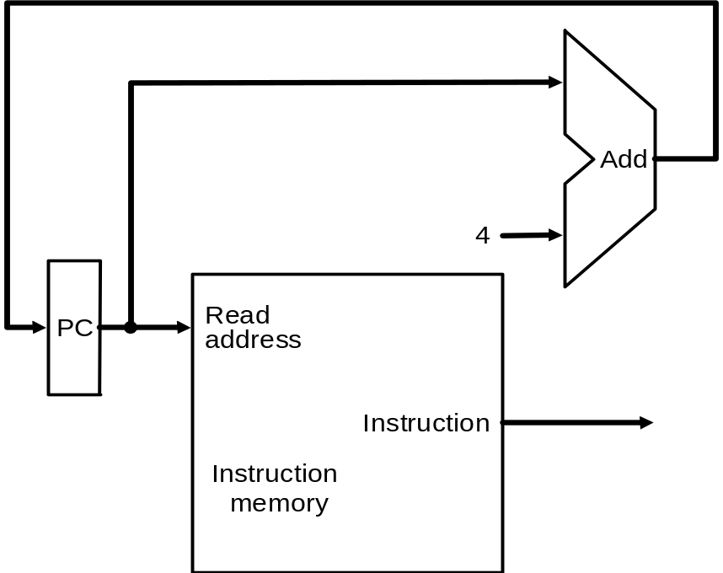
Step 3a: Datapath Assembly
Instruction fetch unit: common operations
  Fetch the instruction: mem[PC]
  Update the program counter:
    Sequential code: PC <- PC + 4
    Branch and Jump: PC <- “Something else”
Single-cycle Design-<number>
Notes:
Now let take a look at the first major component of the datapath: the instruction fetch unit.
The common RTL operations for all instructions are:
(a) Fetch the instruction using the Program Counter (PC) at the beginning of an
instruction execution (PC -> Instruction Memory -> Instruction Word).
(b) Then at the end of the instruction execution, you need to update the
Program Counter (PC -> Next Address Logic -> PC).
More specifically, you need to increment the PC by 4 if you are executing sequential code.
For Branch and Jump instructions, you need to update the program counter to omething else?other than plus 4.
I will show you what is inside this Next Address Logic block when we talked about the Branch and Jump instructions.
For now, let focus our attention to the Add and Subtract instructions.
+2 = 37 min. (Y:17)

Slide 25
Step 3b: Add and Subtract
R[rd] <- R[rs] op R[rt] Ex: add rd, rs, rt
  Ra, Rb, Rw come from inst.’s rs, rt, and rd fields
  ALU and RegWrite: control logic after decode
31
26
21
16
11
6
0
op
rs
rt
rd
shamt
funct
6 bits
5 bits
5 bits
5 bits
5 bits
6 bits
4
A
L
U
o
p
e
r
a
t
i
o
n
(funct)
rs
R
e
a
d
r
e
g
i
s
t
e
r
1
R
e
a
d
rt
R
e
a
d
d
a
t
a
1
I
n
s
t
r
u
c
t
i
o
n
r
e
g
i
s
t
e
r
2
Z
e
r
o
rd
R
e
g
i
s
t
e
r
s
A
L
U
A
L
U
W
r
i
t
e
r
e
s
u
l
t
r
e
g
i
s
t
e
r
R
e
a
d
W
r
i
t
e
d
a
t
a
2
d
a
t
a
R
e
g
W
r
i
t
e
Single-cycle Design-<number>
Notes:
And here is the datapath that can do the trick.
First of all, we connect the register file Ra, Rb, and Rw input to the Rd, Rs, and Rt fields of the instruction bus (points to the format diagram).
Then we need to connect busA and busB of the register file to the ALU.
Finally, we need to connect the output of the ALU to the input bus of the register file.
Conceptually, this is how it works.
The instruction bus coming out of the Instruction memory will set the Ra and Rb to the register specifiers Rs and Rt.
This causes the register file to put the value of register Rs onto busA and the value of register Rt onto busB, respectively.
By setting the ALUctr appropriately, the ALU will perform either the Add and Subtract for us.
The result is then fed back to the register file where the register specifier Rw should already be set to the instruction bus Rd field.
Since the control, which we will design in our next lecture, should have already set the RegWr signal to 1, the result will be written back to the register file at the next clock tick (points to the Clk input).
+3 = 42 min. (Y:22)

Slide 26
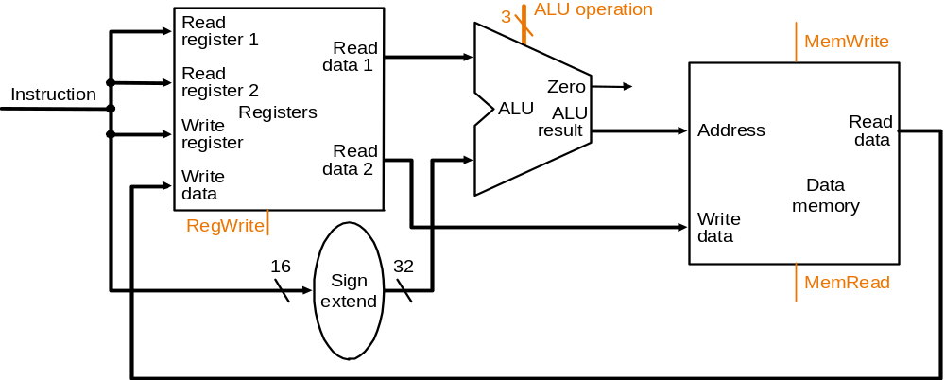
Step 3c: Store/Load Operations
R[rt]<-Mem[R[rs]+SignExt[imm16]] Ex: lw rt,rs,imm16
31
26
21
16
11
0
op
rs
rt
immediate
6 bits
5 bits
5 bits
rd
16 bits
rs
4
rt
rt
Single-cycle Design-<number>
Notes:
Once again we cannot use the instruction Rd field for the Register File Rw input because load is a I-type instruction and there is no such thing as the Rd field in the I format.
So instead of Rd, the Rt field is used to specify the destination register through this two to one multiplexor.
The first operand of the ALU comes from busA of the register file which contains the value of Register Rs (points to the Ra input of the register file).
The second operand, on the other hand, comes from the immediate field of the instruction.
Instead of using the Zero Extender I used in datapath for the or immediate datapath, I have to use a more general purpose Extender that can do both Sign Extend and Zero Extend.
The ALU then adds these two operands together to form the memory address.
Consequently, the output of the ALU has to go to two places:
(a) First the address input of the data memory.
(b) And secondly, also to the input of this two-to-one multiplexer.
The other input of this multiplexer comes from the output of the data memory so we can place the output of the data memory onto the register file input bus for the load instruction.
For Add, Subtract, and the Or immediate instructions, the output of the ALU will be selected to be placed on the input bus of the register file.
In either case, the control signal RegWr should be asserted so the register file will be written at the end of the cycle.
+3 = 60 min. (Y:40)

Slide 27
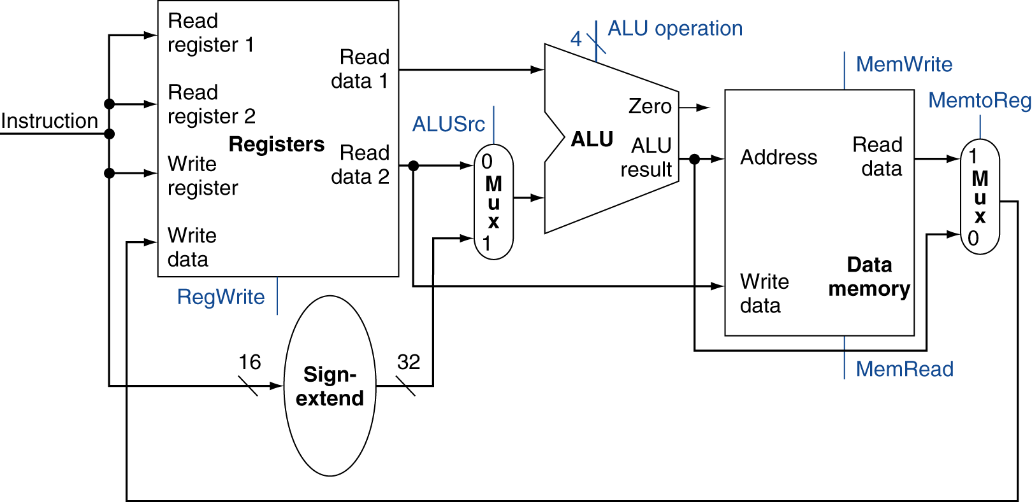
R-Type/Load/Store Datapath
Single-cycle Design-<number>

Slide 28
Step 3d: Branch Operations
beq rs, rt, imm16
  mem[PC] Fetch inst. from memory
  Equal <- R[rs] == R[rt] Calculate branch condition
  if (COND == 0) Calculate next inst. address
    PC <- PC + 4 + ( SignExt(imm16) x 4 )
  else
    PC <- PC + 4
31
26
21
16
0
op
rs
rt
immediate
6 bits
5 bits
5 bits
16 bits
Single-cycle Design-<number>
Notes:
How does the branch on equal instruction work?
Well it calculates the branch condition by subtracting the register selected by the Rt field from the register selected by the Rs field.
If the result of the subtraction is zero, then these two registers are equal and we take a branch. Otherwise, we keep going down the sequential path (PC <- PC +4).
+1 = 65 min. (Y:45)

Slide 29
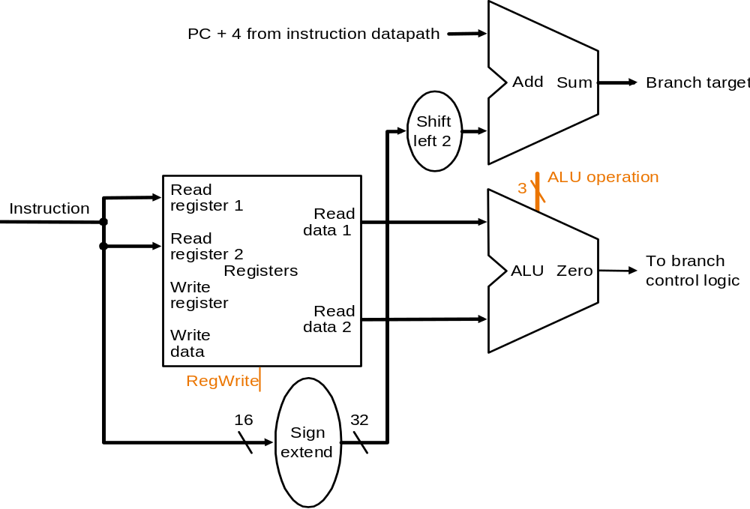
Datapath for Branch Operations
beq rs, rt, imm16
4
Single-cycle Design-<number>
Notes:
The datapath for calculating the branch condition is rather simple.
All we have to do is feed the Rs and Rt fields of the instruction into the Ra and Rb inputs of the register file.
Bus A will then contain the value from the register selected by Rs.
And bus B will contain the value from the register selected by Rt.
The next thing to do is to ask the ALU to perform a subtract operation and feed the output Zero to the next address logic.
How does the next address logic block look like?
Well, before I show you that, let take a look at the binary arithmetics behind the program counter (PC).
+2 = 67 min. (Y:47)

Slide 30
Outline
Introduction to designing a processor
Analyzing the instruction set
Building the datapath
A single-cycle implementation
Control for the single-cycle CPU
  Control of CPU operations
  ALU controller
  Main controller
Single-cycle Design-<number>

Slide 31
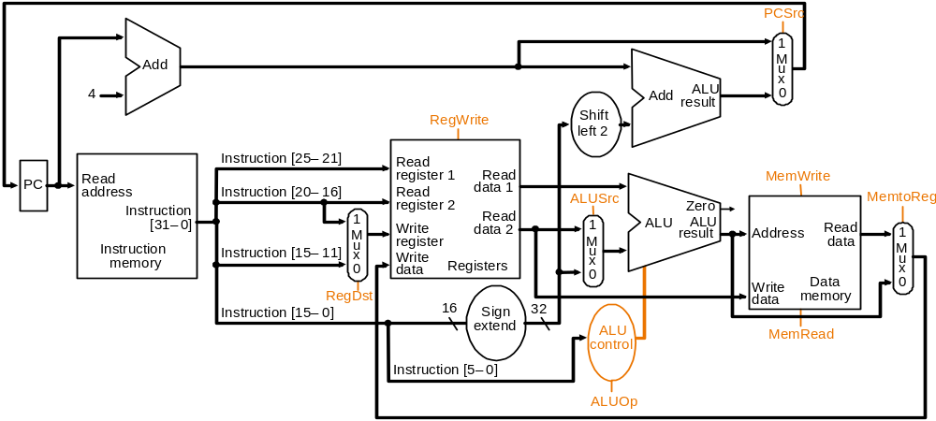
A Single Cycle Datapath
Single-cycle Design-<number>

Slide 32
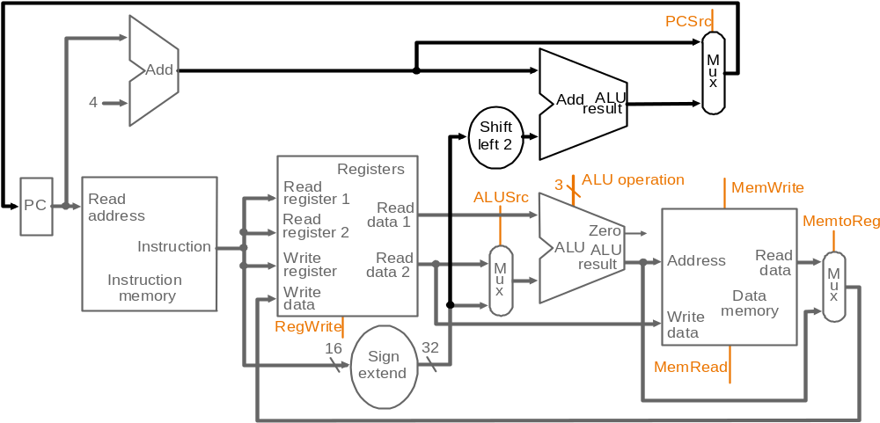
Data Flow during add
4
100..0100

Clocking
data flows in other paths
Single-cycle Design-<number>

Slide 33
Clocking Methodology
Combinational logic transforms data during clock cycles
  Between clock edges
  Input from state elements, output to state element
  Longest delay determines clock period
Single-cycle Design-<number>

Slide 34
Clocking Methodology
Define when signals are read and written
Assume edge-triggered:
  Values in storage (state) elements updated only on a clock edge
  => clock edge should arrive only after input signals stable
  Any combinational circuit must have inputs from and outputs to storage elements
  Clock cycle: time for signals to propagate from one storage element, through combinational circuit, to reach the second storage element
  A register can be read, its value propagated through some combinational circuit, new value is written back to the same register, all in same cycle => no feedback within a single cycle
Single-cycle Design-<number>

Slide 35
Register-Register Timing
Clk
Clk-to-Q
PC
Old Value
New Value
Instruction Memory Access Time
Rs, Rt, Rd,
Op, Func
Old Value
New Value
Delay through Control Logic
ALUctr
Old Value
New Value
RegWr
Old Value
New Value
Register File Access Time
busA, B
Old Value
New Value
ALU Delay
busW
Old Value
New Value
Ideal
Instruction
Memory
32
Rd
Rs
Rt
ALUctr
Register Write
Occurs Here
RegWr
5
5
5
Rw
Ra
Rb
busA
PC
busW
32 32-bit
Registers
32
Result
32
ALU
32
Clk
busB
Clk
32
Notes:
Let take a more quantitative picture of what is happening.
At each clock tick, the Program Counter will present its latest value to the Instruction memory after Clk-to-Q time.
After a delay of the Instruction Memory Access time, the Opcode, Rd, Rs, Rt, and Function fields will become valid on the instruction bus.
Once we have the new instruction, that is the Add or Subtract instruction, on the instruction bus, two things happen in parallel.
First of all, the control unit will decode the Opcode and Func field and set the control signals ALUctr and RegWr accordingly. We will cover this in the next lecture.
While this is happening (points to Control Delay), we will also be reading the register file (Register File Access Time).
Once the data is valid on busA and busB, the ALU will perform the Add or Subtract operation based on the ALUctr signal.
Hopefully, the ALU is fast enough that it will finish the operation (ALU Delay) before the next clock tick.
At the next clock tick, the output of the ALU will be written into the register file because the RegWr signal will be equal to 1.
+3 = 45 min. (Y:25)

Slide 36
The Critical Path
Register file and ideal memory:
  During read, behave as combinational logic:
    Address valid => Output valid after access time
Critical Path (Load Operation) =
PC’s Clk-to-Q +
Instruction memory’s Access Time +
Register file’s Access Time +
ALU to Perform a 32-bit Add +
Data Memory Access Time +
Setup Time for Register File Write +
Clock Skew
Ideal
Instruction
Memory
Instruction
Rd
Rs
Rt
Imm
5
5
5
16
Instruction
Address
A
Data
Address
Rw
Ra
Rb
32
32
32
Ideal
Data
Memory
Next Address
32 32-bit
Registers
ALU
PC
Data In
B
Clk
Clk
Clk
32
Single-cycle Design-<number>
Notes:
Now with the clocking methodology back in your mind, we can think about how the critical path of our bstract?datapath may look like.
One thing to keep in mind about the Register File and Ideal Memory (points to both Instruction and Data) is that the Clock input is a factor ONLY during the write operation.
For read operation, the CLK input is not a factor. The register file and the ideal memory behave as if they are combinational logic.
That is you apply an address to the input, then after certain delay, which we called access time, the output is valid.
We will come back to these points (point to the ehave?bullets) later in this lecture.
But for now, let look at this bstract?datapath critical path which occurs when the datapath tries to execute the Load instruction.
The time it takes to execute the load instruction are the sum of:
(a) The PC clock-to-Q time.
(b) The instruction memory access time.
(c) The time it takes to read the register file.
(d) The ALU delay in calculating the Data Memory Address.
(e) The time it takes to read the Data Memory.
(f) And finally, the setup time for the register file and clock skew.
+3 = 21 (Y:01)

Slide 37
Worst Case Timing (Load)
Clk
Clk-to-Q
PC
Old Value
New Value
Instruction Memoey Access Time
Rs, Rt, Rd,
Op, Func
Old Value
New Value
Delay through Control Logic
ALUctr
Old Value
New Value
ExtOp
Old Value
New Value
ALUSrc
Old Value
New Value
MemtoReg
Old Value
New Value
Register
Write Occurs
RegWr
Old Value
New Value
Register File Access Time
busA
Old Value
New Value
Delay through Extender & Mux
busB
Old Value
New Value
ALU Delay
Address
Old Value
New Value
Data Memory Access Time
busW
Old Value
Single-cycle Design-<number>
New
Notes:
This timing diagram shows the worst case timing of our single cycle datapath which occurs at the load instruction.
Clock to Q time after the clock tick, PC will present its new value to the Instruction memory.
After a delay of instruction access time, the instruction bus (Rs, Rt, ...) becomes valid.
Then three things happens in parallel:
(a) First the Control generates the control signals (Delay through Control Logic).
(b) Secondly, the regiser file is access to put Rs onto busA.
(c) And we have to sign extended the immediate field to get the second operand (busB).
Here I asuume register file access takes longer time than doing the sign extension so we have to wait until busA valid before the ALU can start the address calculation (ALU delay).
With the address ready, we access the data memory and after a delay of the Data Memory Access time, busW will be valid.
And by this time, the control unit whould have set the RegWr signal to one so at the next clock tick, we will write the new data coming from memory (busW) into the register file.
+3 = 77 min. (Y:57)

Slide 38
Outline
Introduction to designing a processor
Analyzing the instruction set
Building the datapath
A single-cycle implementation
Control for the single-cycle CPU
  Control of CPU operations (step 4)
  ALU controller
  Main controller
Single-cycle Design-<number>

Slide 39
Step 4: Control Points and Signals
Instruction<31:0>
Inst.
Memory
<21:25>
<21:25>
<16:20>
<11:15>
<0:15>
Addr
Op
Funct
Rt
Rs
Rd
Imm16
Control
PCsrc
RegDst
ALUSrc
MemWr
MemtoReg
RegWr
MemRd
ALUctr
Equal
Datapath
Single-cycle Design-<number>

Slide 40
Designing Main Control
Some observations:
  opcode (Op[5-0]) is always in bits 31-26
  two registers to be read are always in rs (bits 25-21) and rt (bits 20-16) (for R-type, beq, sw)
  base register for lw and sw is always in rs (25-21)
  16-bit offset for beq, lw, sw is always in 15-0
  destination register is in one of two positions:
    lw: in bits 20-16 (rt)
    R-type: in bits 15-11 (rd)
    => need a multiplex to select the address for written register
Single-cycle Design-<number>

Slide 41
Datapath with Mux and Control
Control point
Single-cycle Design-<number>

Slide 42
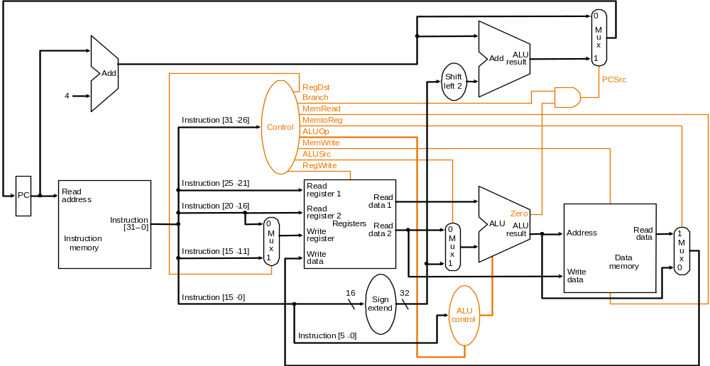
Datapath with Control Unit
Single-cycle Design-<number>

Slide 43
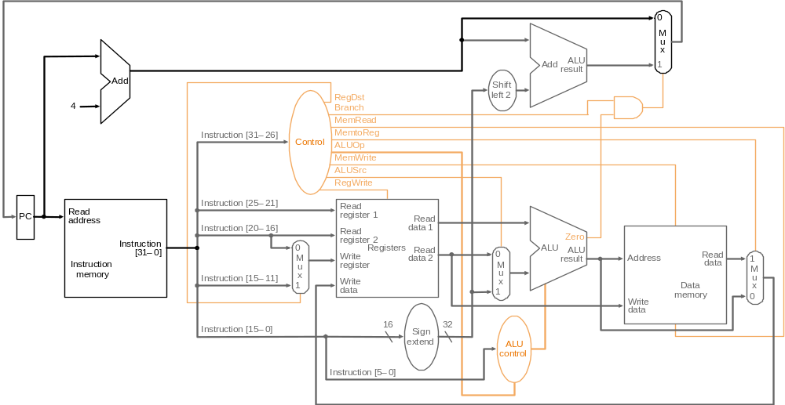
Instruction Fetch at Start of Add
instruction <- mem[PC]; PC + 4
Single-cycle Design-<number>

Slide 44
Instruction Decode of Add
Fetch the two operands and decode instruction:
Single-cycle Design-<number>

Slide 45
ALU Operation during Add
R[rs] + R[rt]
Single-cycle Design-<number>

Slide 46
Write Back at the End of Add
R[rd] <- ALU; PC <- PC + 4
Single-cycle Design-<number>

Slide 47
Datapath Operation for lw
R[rt] <- Memory {R[rs] + SignExt[imm16]}
Single-cycle Design-<number>

Slide 48
Datapath Operation for beq
if (R[rs]-R[rt]==0) then Zero<-1 else Zero<-0
if (Zero==1) then PC=PC+4+signExt[imm16]*4; else PC = PC + 4
Single-cycle Design-<number>

Slide 49
Outline
Designing a processor
Analyzing the instruction set
Building the datapath
A single-cycle implementation
Control for the single-cycle CPU
  Control of CPU operations
  ALU controller (step 5a)
  Main controller
Single-cycle Design-<number>

Slide 50
Datapath with Control Unit
Single-cycle Design-<number>

Slide 51
Step 5a: ALU Control
ALU used for
  Load/Store: F = add
  Branch: F = subtract
  R-type: F depends on funct field
ALU control | Function
0000 | AND
0001 | OR
0010 | add
0110 | subtract
0111 | set-on-less-than
1100 | NOR
Single-cycle Design-<number>

Slide 52
Our Plan for the Controller
7
func
ALUop is 2-bit wide to represent:
  “I-type” requiring the ALU to perform:
    (00) add for load/store and (01) sub for beq
  “R-type” (10), need to reference func field
Op code
Main
Control
6
ALU
Control
(Local)
ALUctr
6
ALUop
3
ALU
2
31
26
21
16
11
6
0
R-type
op
rs
rt
rd
shamt
funct
R-type
lw
sw
beq
jump
ALUop (Symbolic)
“R-type”
Add
Add
Subtract
xxx
ALUop<1:0>
10
00
00
01
xxx
Single-cycle Design-<number>
Notes:
Well the answer is 2 because we only need to represent 4 things: -type,?the Or operation, the Add operation, and the Subtract operation.
If you are implementing the entire MIPS instruction set, then ALUop has to be 3 bits wide because we will need to repreent 5 things: R-type, Or, Add, Subtract, and AND.
Here I show you the bit assignment I made for the 3-bit ALUop.
With this bit assignment in mind, let figure out what the local control ALU Control has to do.
+1 = 26 min. (Y:26)

Slide 53
ALU Control
Assume 2-bit ALUOp derived from opcode
  Combinational logic derives ALU control
opcode | ALUOp | Operation | funct | ALU function | ALU control
lw | 00 | load word | XXXXXX | add | 0010
sw | 00 | store word | XXXXXX | add | 0010
beq | 01 | branch equal | XXXXXX | subtract | 0110
R-type | 10 | add | 100000 | add | 0010
 |  | subtract | 100010 | subtract | 0110
 |  | AND | 100100 | AND | 0000
 |  | OR | 100101 | OR | 0001
 |  | set-on-less-than | 101010 | set-on-less-than | 0111
Single-cycle Design-<number>

Slide 54
Logic Equation for ALUctr
ALUop
func
ALUctr
bit<1>
bit<0>
bit<5>
bit<4>
bit<3>
bit<2>
bit<1>
bit<0>
bit<3>
bit<2>
bit<1>
bit<0>
0
0
x
x
x
x
x
x
0
0
1
0
x
1
x
x
x
x
x
x
0
1
1
0
1
x
x
x
0
0
0
0
0
0
1
0
1
x
x
x
0
0
1
0
0
1
1
0
1
x
x
x
0
1
0
0
0
0
0
0
1
x
x
x
0
1
0
1
0
0
0
1
1
x
x
x
1
0
1
0
0
1
1
1
Single-cycle Design-<number>

Slide 55
Logic Equation for ALUctr2
ALUop
func
bit<1>
bit<0>
bit<5>
bit<4>
bit<3>
bit<2>
bit<1>
bit<0>
ALUctr<2>
x
1
x
x
x
x
x
x
1
1
x
x
x
0
0
1
0
1
1
x
x
x
1
0
1
0
1
This makes func<3> a don’t care
ALUctr2 = ALUop0
+ ALUop1‧func2’‧func1‧func0’
Single-cycle Design-<number>
Notes:
From the truth table we had before the break, we can derive the logic equation for ALUctr bit 2 but collecting all the rows that has ALUCtr bit 2 equals to 1 and this table is the result.
Each row becomes a product term and we need to OR the prodcut terms together.
Notice that the last row are identical except the bit<3> of the func fields. One is zero and the other is one. Together, they make bit<3> a don care term.
With all these don care terms, the logic equation is rather simple.
The first prodcut term is: not ALUOp<2> and ALUOp<0>.
The second product term, after we making Func<3> a don care becomes ...
+2 = 57 min. (Y:37)

Slide 56
Logic Equation for ALUctr1
ALUop
func
bit<1>
bit<0>
bit<5>
bit<4>
bit<3>
bit<2>
bit<1>
bit<0>
ALUctr<1>
0
0
x
x
x
x
x
x
1
x
1
x
x
x
x
x
x
1
1
x
x
x
0
0
0
0
1
1
x
x
x
0
0
1
0
1
1
x
x
x
1
0
1
0
1
ALUctr1 = ALUop1’
+ ALUop1‧func2’‧func0’
Single-cycle Design-<number>
Notes:
Here is the truth table when we collect all the rows whereALCctr bit<1> equals to 1.
Once again, we can simplify the table by noticing that the first two rows are different only at the ALUop bit<0> position. We can make ALUop bit<0> into a don care.
Similarly, the last three rows can be combined to make Func bit<3> and bit<1> into don cares.
Consequently, the logic equation for ALUctr bit<1> becomes ...
+2 = 59 min. (Y:39)

Slide 57
Logic Equation for ALUctr0
ALUop
func
bit<1>
bit<0>
bit<5>
bit<4>
bit<3>
bit<2>
bit<1>
bit<0>
ALUctr<0>
1
x
x
x
0
1
0
1
1
1
x
x
x
1
0
1
0
1
ALUctr0 = ALUop1
‧func3’‧func2‧func1’‧func0
+ ALUop1’‧func3
‧func2’‧func1‧func0’
Single-cycle Design-<number>
Notes:
Finally, after we gather all the rows where ALUctr bit 0 are 1, we have this truth table.
Well, we are out of luck here. I don see any simple way to simplify these product terms by just looking at them.
There may be some if you draw out the 7 dimension K map but I am not going to try it.
So I just write down the logic equations as it is.
+2 = 61 min. (Y:41)

Slide 58
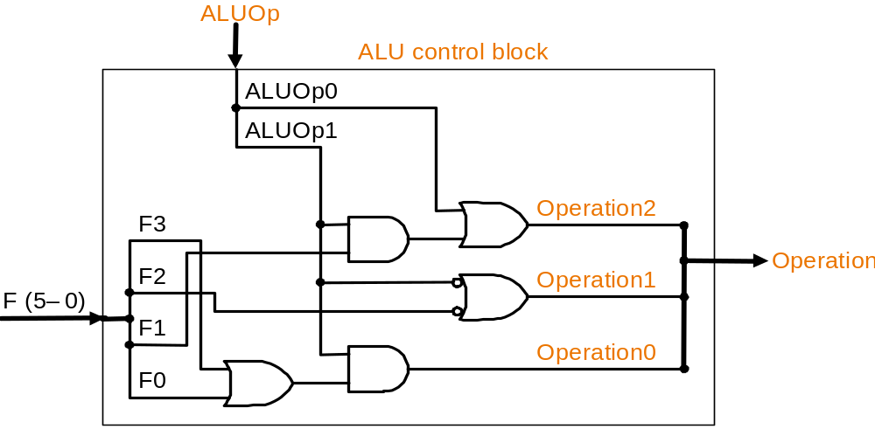
The Resultant ALU Control Block
Single-cycle Design-<number>

Slide 59
Outline
Introduction to designing a processor
Analyzing the instruction set
Building the datapath
A single-cycle implementation
Control for the single-cycle CPU
  Control of CPU operations
  ALU controller
  Main controller (step 5b)
Single-cycle Design-<number>

Slide 60
Step 5b: The Main Control Unit
Control signals derived from instruction
R-type
0
rs
rt
rd
shamt
funct
31:26
25:21
20:16
15:11
10:6
5:0
Load/
Store
35 or 43
rs
rt
address
31:26
25:21
20:16
15:0
Branch
4
rs
rt
address
31:26
25:21
20:16
15:0
opcode
always read
read, except for load
write for R-type and load
sign-extend and add
Single-cycle Design-<number>

Slide 61
Truth Table of Control Signals
See
func
10 0000
10 0010
We Don’t Care :-)
Appendix A
op
00 0000
00 0000
10 0011
10 1011
00 0100
add
sub
lw
sw
beq
RegDst
1
1
0
x
x
ALUSrc
0
0
1
1
0
MemtoReg
0
0
1
x
x
RegWrite
1
1
1
0
0
MemRead
0
0
1
0
0
MemWrite
0
0
0
1
0
Branch
0
0
0
0
1
ALUop1
1
1
0
0
0
ALUop0
0
0
0
0
1
RegDst
func
ALUSrc
ALU
Control
(Local)
ALUctr
Op code
Main
Control
:
6
4
6
ALUop
2
Single-cycle Design-<number>
Notes:
Here is a table summarizing the control signals setting for the seven (add, sub, ...) instructions we have looked at.
Instead of showing you the exact bit values for the ALU control (ALUctr), I have used the symbolic values here.
The first two columns are unique in the sense that they are R-type instrucions and in order to uniquely identify them, we need to look at BOTH the op field as well as the func fiels.
Ori, lw, sw, and branch on equal are I-type instructions and Jump is J-type. They all can be uniquely idetified by looking at the opcode field alone.
Now let take a more careful look at the first two columns. Notice that they are identical except the last row.
So we can combine these two rows here if we can elay?the generation of ALUctr signals.
This lead us to something call ocal decoding.
+3 = 42 min. (Y:22)

Slide 62
Truth Table for RegWrite
Op code
00 0000
10 0011
10 1011
00 0100
R-type
lw
sw
beq
RegWrite
1
1
0
0
RegWrite = R-type + lw
  = op5’‧op4’‧op3’‧op2’‧op1’‧op0’ (R-type)
  + op5‧op4’‧op3’‧op2’‧op1‧ op0 (lw)
.
.
.
.
.
op<5>
.
op<5>
.
op<5>
.
op<5>
.
op<5>
.
<0>
<0>
<0>
<0>
op<0>
R-type
lw
sw
beq
jump
RegWrite
X
Single-cycle Design-<number>
Notes:
For example, consider the control signal RegWrite.
If we treat all the don’t cares as zeros, this row here means RegDest has to be equal to one whenever we have a R-type, or an OR immediate, or a load instruction.
Since we can determine whether we have any of these instructions (point to the column headers) by looking at the bits in the P?field, we can transform this symbolic equation to this binary logic equation.
For example, the first product term here say we have a R-type instruction whenever all the bits in the OP field are zeros.
So each of these big AND gates implements one of the columns (R-type, ori, ...) in our table. Or in more technical terms, each AND gate implements a product term.
In order to finish implementing this logic equation, we have to OR the proper terms together.
In the case of the RegWrite signal, we need to OR the R-type, ORi, and load terms together.
+2 = 67 min. (Y:47)

Slide 63
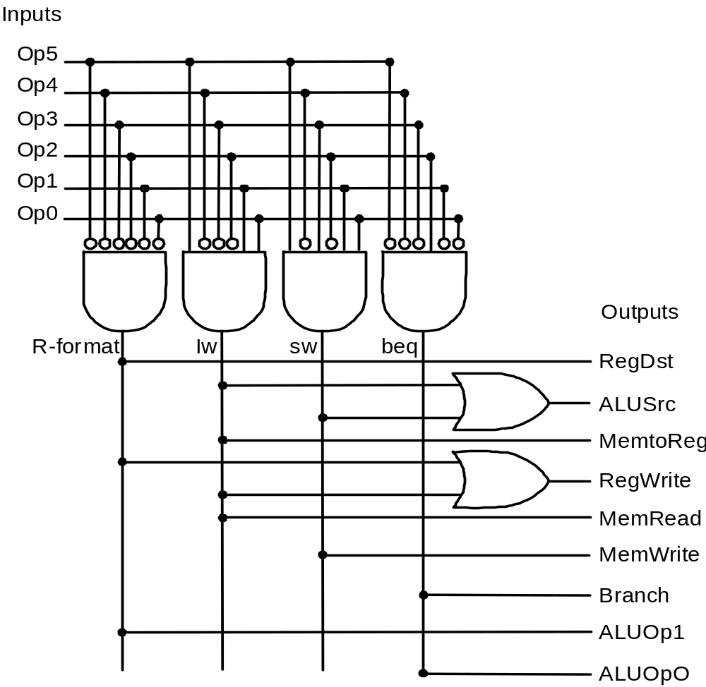
PLA Implementing Main Control
Single-cycle Design-<number>

Slide 64
Implementing Jumps
Jump
2
address
31:26
25:0
Jump uses word address
Update PC with concatenation of
  Top 4 bits of old PC
  26-bit jump address
  00
Need an extra control signal decoded from opcode
Single-cycle Design-<number>

Slide 65
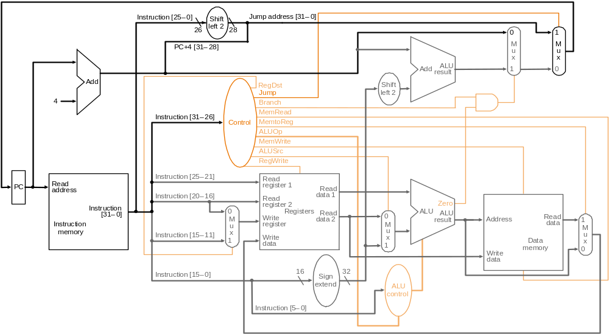
Putting it Altogether (+ jump instruction)
Single-cycle Design-<number>

Slide 66
Worst Case Timing (Load)
Clk
Clk-to-Q
PC
Old Value
New Value
Instruction Memoey Access Time
Rs, Rt, Rd,
Op, Func
Old Value
New Value
Delay through Control Logic
ALUctr
Old Value
New Value
ExtOp
Old Value
New Value
ALUSrc
Old Value
New Value
MemtoReg
Old Value
New Value
Register
Write Occurs
RegWr
Old Value
New Value
Register File Access Time
busA
Old Value
New Value
Delay through Extender & Mux
busB
Old Value
New Value
ALU Delay
Address
Old Value
New Value
Data Memory Access Time
busW
Old Value
New
Notes:
This timing diagram shows the worst case timing of our single cycle datapath which occurs at the load instruction.
Clock to Q time after the clock tick, PC will present its new value to the Instruction memory.
After a delay of instruction access time, the instruction bus (Rs, Rt, ...) becomes valid.
Then three things happens in parallel:
(a) First the Control generates the control signals (Delay through Control Logic).
(b) Secondly, the regiser file is access to put Rs onto busA.
(c) And we have to sign extended the immediate field to get the second operand (busB).
Here I asuume register file access takes longer time than doing the sign extension so we have to wait until busA valid before the ALU can start the address calculation (ALU delay).
With the address ready, we access the data memory and after a delay of the Data Memory Access time, busW will be valid.
And by this time, the control unit whould have set the RegWr signal to one so at the next clock tick, we will write the new data coming from memory (busW) into the register file.
+3 = 77 min. (Y:57)

Slide 67
Drawback of Single-Cycle Design
Long cycle time:
  Cycle time must be long enough for the load instruction:
    PC’s Clock -to-Q +
    Instruction Memory Access Time +
    Register File Access Time +
    ALU Delay (address calculation) +
    Data Memory Access Time +
    Register File Setup Time +
    Clock Skew
Cycle time for load is much longer than needed for all other instructions
Single-cycle Design-<number>
Notes:
Well, the last slide pretty much illustrate one of the biggest disadvantage of the single cycle implementation: it has a long cycle time.
More specifically, the cycle time must be long enough for the load instruction which has the following components: Clock to Q time of the PC, ....
Having a long cycle time is a big problem but not the the only problem.
Another problem of this single cycle implementation is that this cycle time, which is long enough for the load instruction, is too long for all other instructions.
We will show you why this is bad and what we can do about it in the next few lectures.
That all for today.
+2 = 79 min (Y:59)

Slide 68
Summary
Single cycle datapath => CPI=1, Clock cycle time long
MIPS makes control easier
  Instructions same size
  Source registers always in same place
  Immediates same size, location
  Operations always on registers/immediates
Single-cycle Design-<number>

